Slide 1


DSA0216- Computer Vision With Open CV For Modern AI AquaVision: Image-Based Water Turbidity and Pollution Estimation System Using OpenCV
SIMATS ENGINEERING Saveetha Institute of Medical and Technical Sciences Chennai-602105.
Presented By:
Supervisor
S. HARI PRASATH (192424423)
A. MILAN (192424377)
P T. ROHAN(192424112)
Dr S. Senthilvadivu
Dr T. Kumaragurubaran
,

Slide 2
Abstract
Aqua Vision is a computer vision–based water quality monitoring system that uses a normal camera and OpenCV to estimate water turbidity and visible pollution. Instead of using costly physical sensors, our system captures images of water bodies and processes them using image preprocessing techniques like noise removal, color space conversion, and contrast enhancement. We then extract visual features such as color distribution, edge sharpness, and texture smoothness. Turbidity is estimated by analyzing how much edges and contrast degrade due to suspended particles in water. Using HSV color segmentation, we detect visual pollutants such as algae, mud, oil patches, and floating waste. Based on these features, the system classifies the water as clean, moderately polluted, or heavily polluted and displays the turbidity score and pollution level through a simple user interface. AquaVision provides a low-cost, scalable, and software-only solution for real-time water quality monitoring.

Slide 3
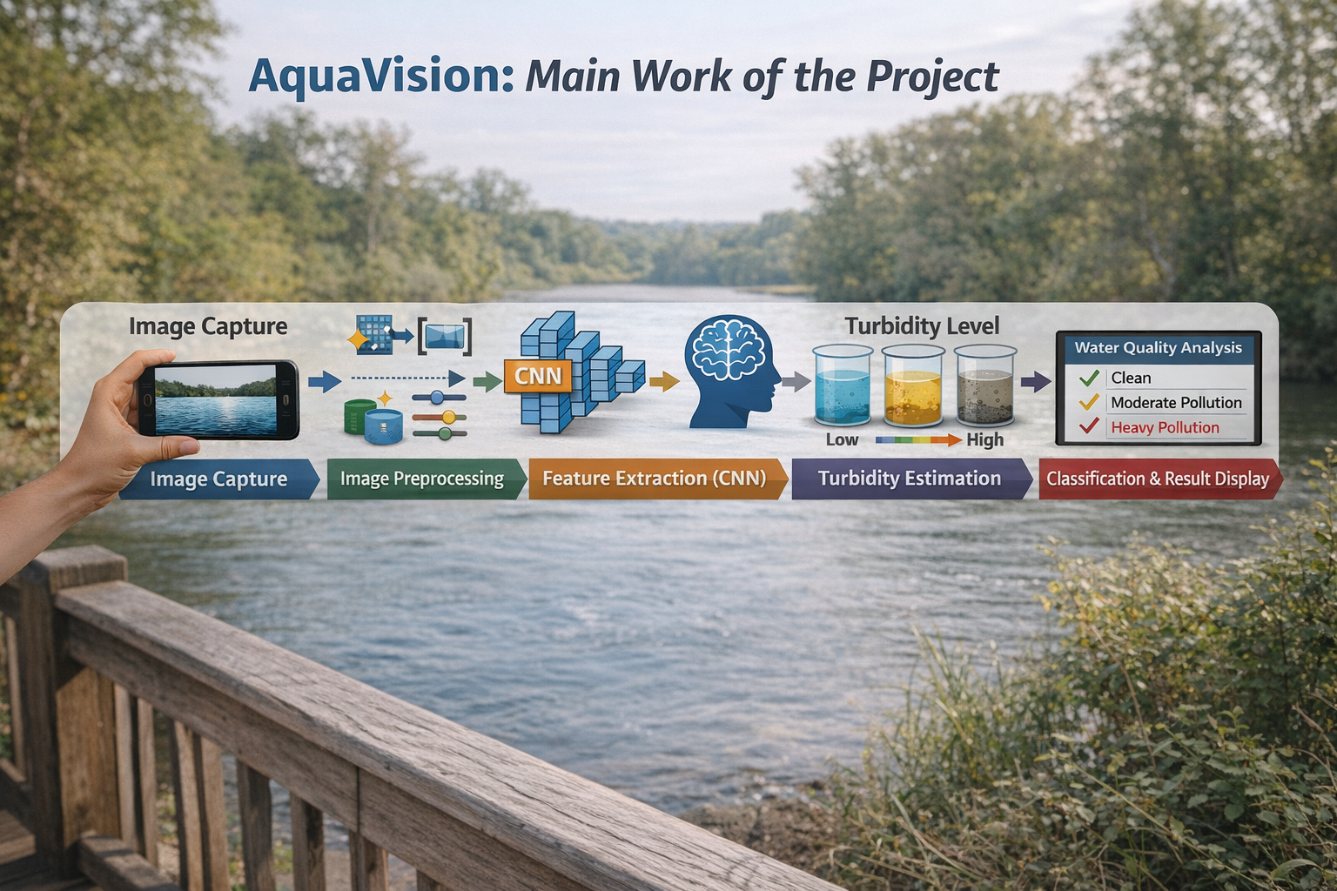
INTRODUCTION
Image Capture: The system captures water images using a mobile camera to enable real-time monitoring and analysis of water quality.
Image Preprocessing: OpenCV is used to remove noise, resize the image, enhance contrast, and convert color spaces to prepare the image for accurate processing.
Feature Extraction (CNN): A Convolutional Neural Network (CNN) automatically extracts important visual features such as color variations, texture patterns, and clarity changes from the water images.
Turbidity Estimation: Based on the extracted features, the system estimates the turbidity level, which indicates the presence of suspended particles and cloudiness in the water.
Classification & Result Display:The system classifies the water as Clean, Moderately Polluted, or Heavily Polluted and displays the turbidity level and pollution status in real time.

Slide 4
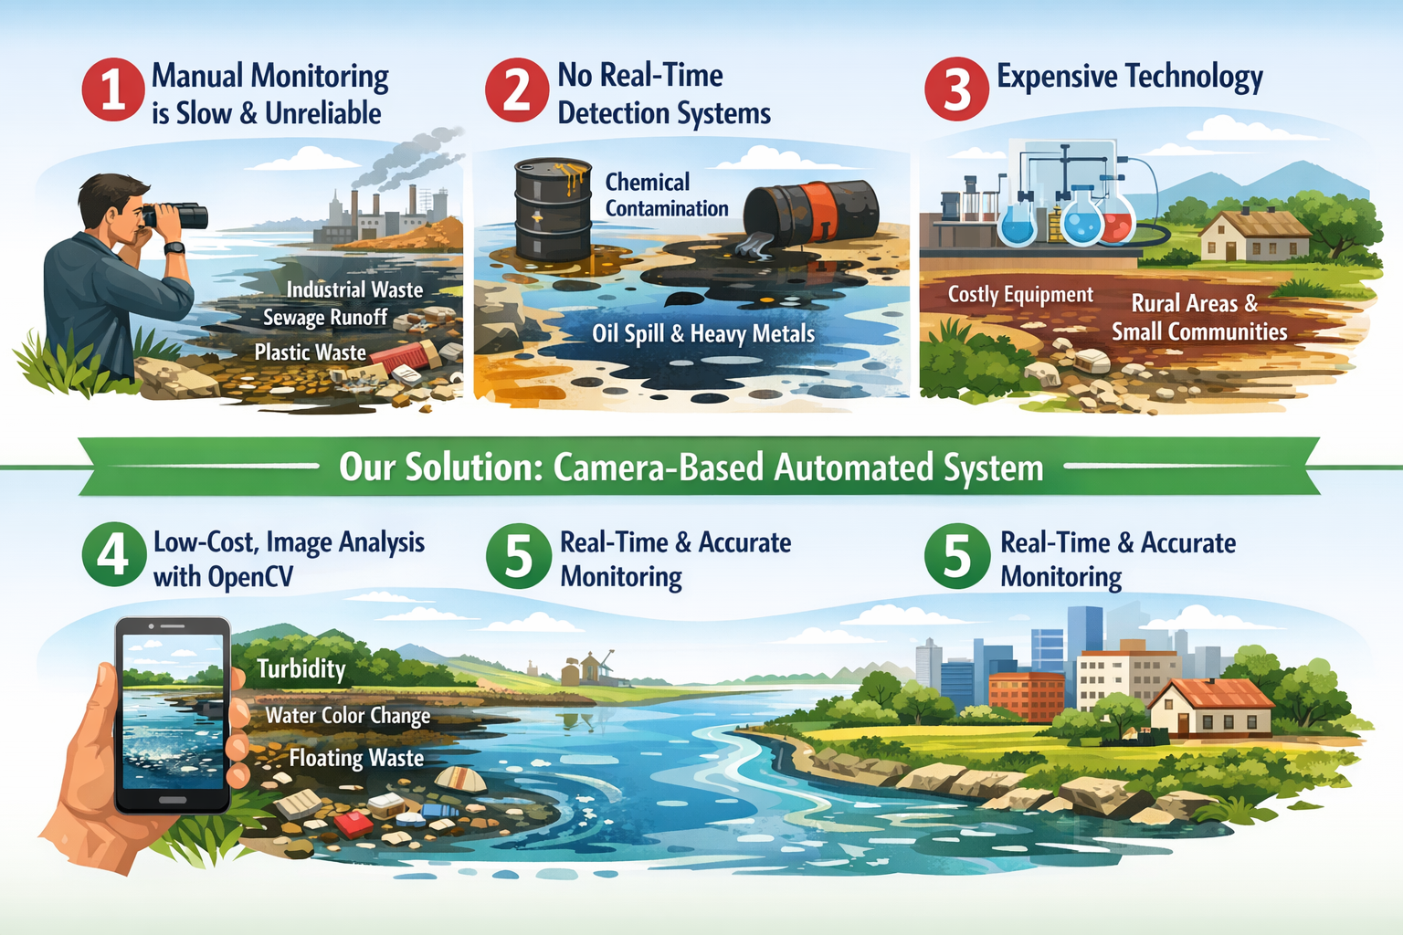
PROBLEM STATEMENT
Manual monitoring is slow and unreliable, especially when pollution increases due to industrial waste, sewage discharge, plastic dumping, and agricultural runoff.
Lack of real-time systems makes it hard to detect pollution like chemical contamination, oil spills, and heavy metals before serious environmental damage occurs.
Existing solutions are expensive, and many rural or small areas affected by untreated wastewater and factory effluents cannot afford advanced monitoring systems.
Our project develops a low-cost, camera-based system using OpenCV to detect pollution indicators such as water color change, turbidity, and floating waste automatically.
The system provides real-time and accurate monitoring, helping reduce risks and enabling faster action against pollution sources.

Slide 5
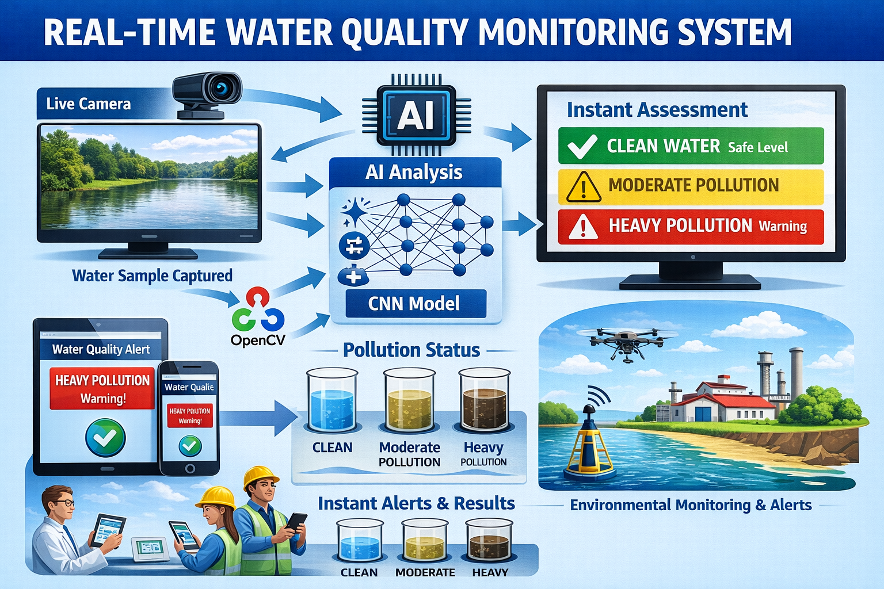
OBJECTIVE
To design an intelligent image-based water quality assessment system that replaces traditional laboratory testing with a faster and automated computer vision approach.
To collect and preprocess water images using OpenCV, including noise removal, resizing, contrast enhancement, and color space conversion for better analysis accuracy.
To implement a Convolutional Neural Network (CNN) model that automatically learns and extracts important visual features such as color distribution, texture patterns, and turbidity indicators from water images.
To train the CNN model to classify pollution levels accurately, enabling the system to differentiate between clean, moderately polluted, and heavily polluted water samples.

Slide 6
LITERATURE SURVEY
S.No | Author(s) & Year | Title | Methodology Used | Key Findings | Limitation
1 | Zhou et al., 2024 | Video Image Intelligent Recognition for Water Turbidity Monitoring | Deep Learning (ResNet), Transfer Learning, Image Regression | Achieved high accuracy in river turbidity estimation under varying lighting conditions | Requires large training dataset and computational power
2 | Mohammed, 2024 | Determine Water Turbidity Using Image Processing Technology | CNN-based classification using Python | Achieved ~91% accuracy in turbidity classification | Mostly tested in controlled laboratory conditions
3 | Nie et al., 2024 | Improved CNN Model for Water Turbidity Classification | Optimized CNN architecture with noise augmentation | Improved prediction accuracy in noisy environments | Model complexity increases training time
4 | Luviano Soto et al., 2024 | Image-Based Water Turbidity Classification Using CNN | EfficientNet-B0 with Transfer Learning | Achieved very high classification accuracy (~99%) | Requires standardized image capture conditions
5 | Miglino et al., 2024 | Continuous River Turbidity Monitoring Using Camera Systems | Field-based digital imaging, regression analysis | Demonstrated cost-effective real-time monitoring in natural environments | Environmental factors (rain, reflection) affect performance

Slide 7
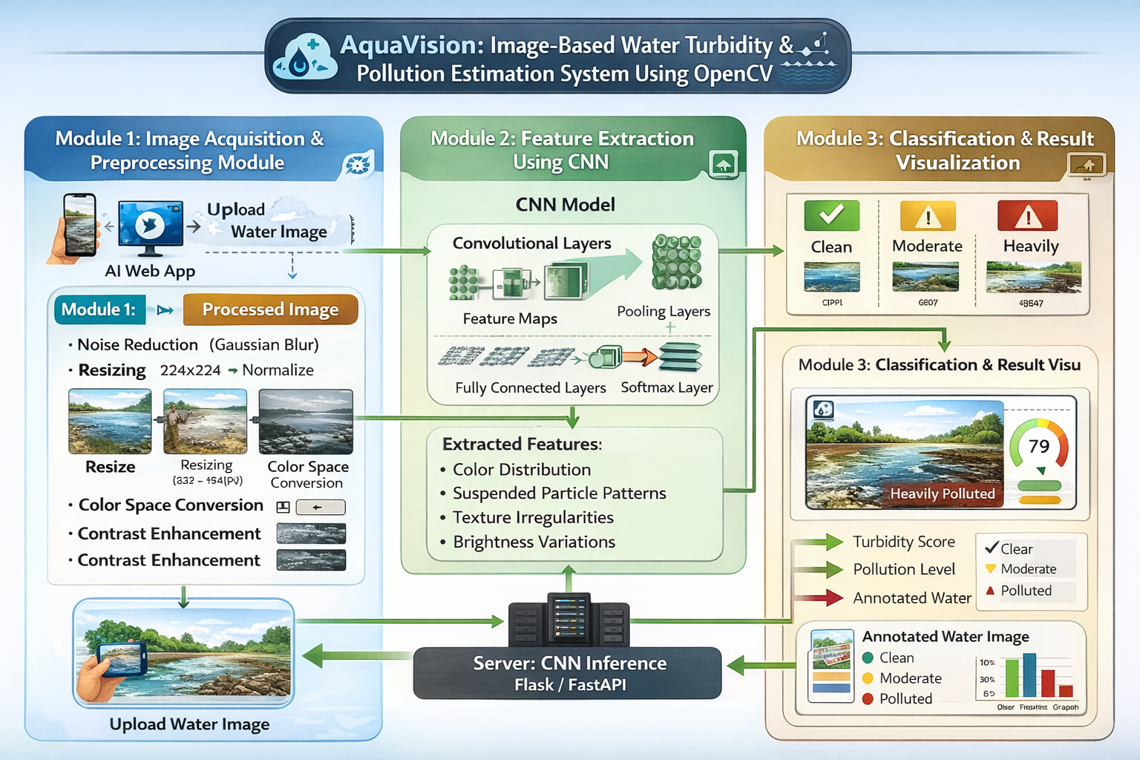
ARCHITECTURE DIAGRAM

Slide 8
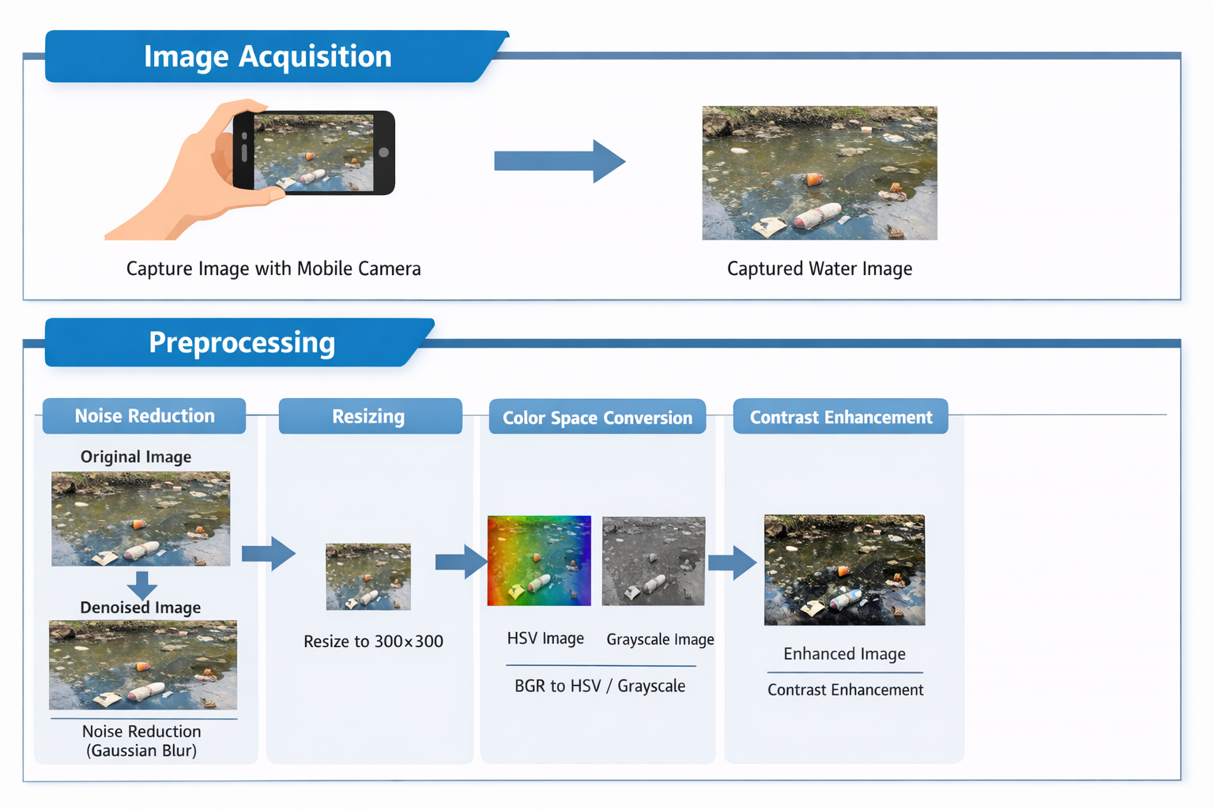
Module 1: Image Acquisition & Preprocessing
🔸 Image Acquisition
The system captures water images using a mobile camera.
The captured image becomes the input for further processing.
🔸 Preprocessing
Noise Reduction – Removes unwanted camera noise using Gaussian Blur.
Resizing – Standardizes image size for consistent processing.
Color Space Conversion – Converts BGR to HSV or Grayscale for better color and clarity analysis.
Contrast Enhancement – Improves visibility of water particles.

Slide 9
Module 2 : Feature Extraction & Analysis With CNN
Automatic Feature Extraction – CNN detects key visual patterns like edges, textures, and color variations without manual input.
Color Analysis – Identifies green (algae), brown (mud), and dark patches (oil/waste) from water images.
Texture & Edge Analysis – Smooth textures indicate clean water; rough textures and blurred edges indicate pollution.
Turbidity Feature Measurement – Combines edge variance and contrast to estimate water clarity.
Classification Preparation – Extracted features are flattened and passed to CNN layers for predicting Clean, Moderately Polluted, or Heavily Polluted water.

Slide 10
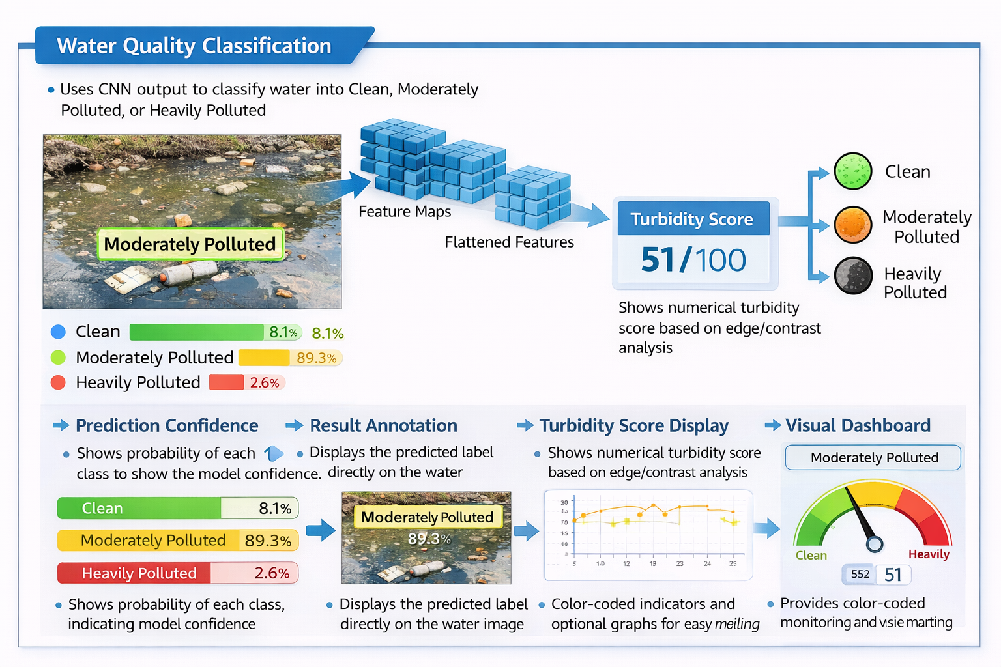
Module 3: Classification & Result Visualization
Water Quality Classification – Uses CNN output to classify water into Clean, Moderately Polluted, or Heavily Polluted.
Prediction Confidence – Calculates the probability of each class to show the model’s confidence.
Result Annotation – Displays the predicted label directly on the water image for easy interpretation.
Turbidity Score Display – Shows numerical turbidity score based on edge and contrast analysis.
Visual Dashboard – Provides color-coded indicators (Green, Yellow, Red) and optional graphs for easy monitoring and decision-making.

Slide 11
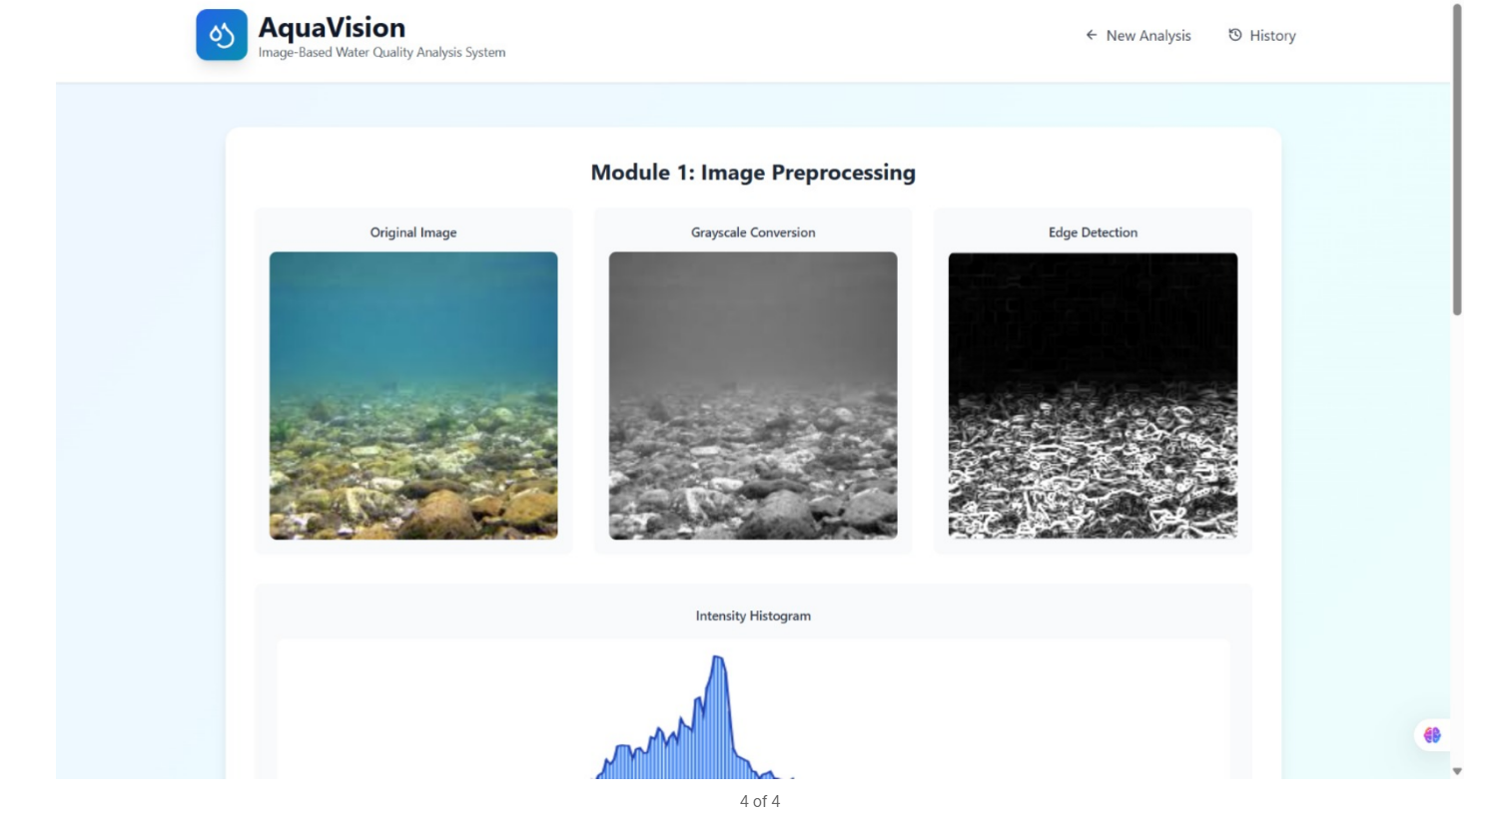

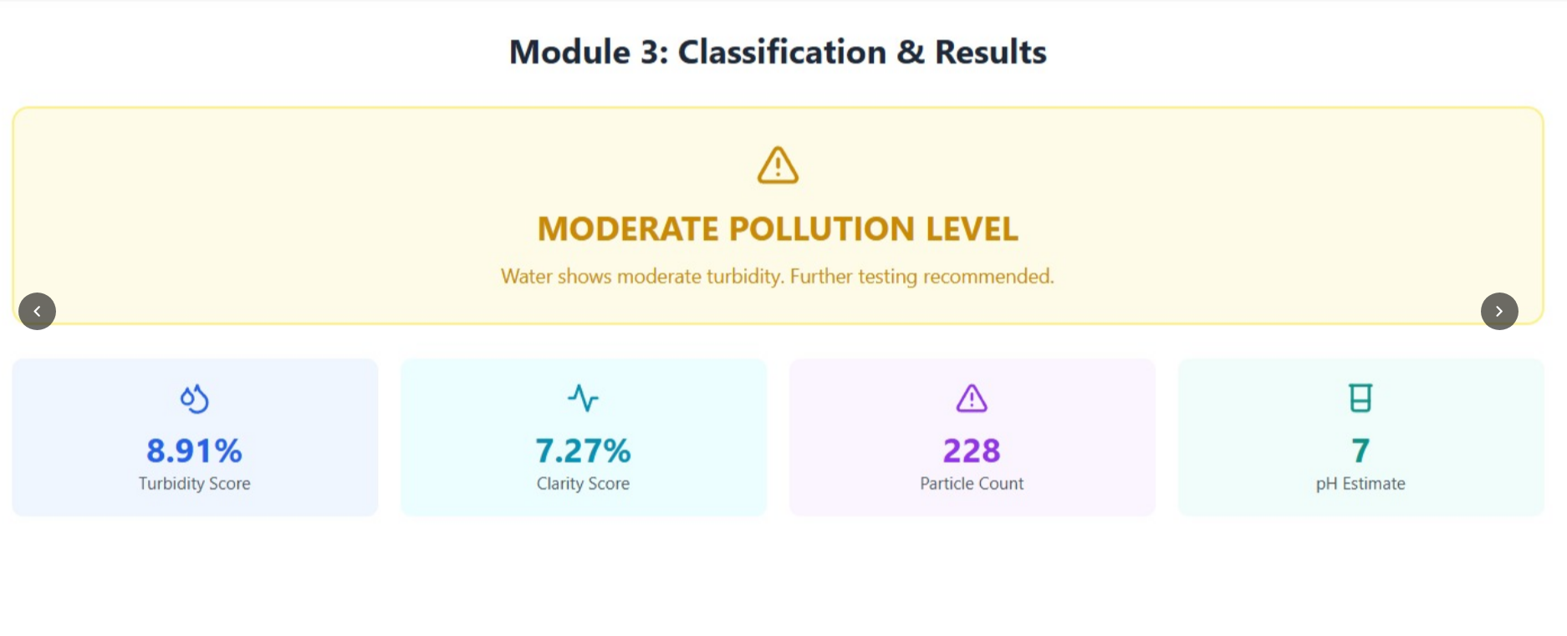
OUTPUT

Slide 12
FUTURE ENHANCEMENT
Machine Learning Integration – Implement deep learning models to automatically classify types of pollutants (plastics, oil, sediments) for more accurate detection.
Multi-Spectral Imaging – Use infrared or UV imaging to detect invisible contaminants and provide a more comprehensive water quality assessment.
IoT and Real-Time Monitoring – Integrate with IoT sensors and cameras for continuous, automated water monitoring across multiple locations.
Cloud-Based Data Analytics – Store and analyze collected data on the cloud for trend analysis, pollution tracking, and predictive alerts.
Mobile Application Interface – Develop a mobile app to provide real-time water quality updates and visual alerts for users and authorities.

Slide 13
CONCLUSION
Real-time water quality monitoring – AquaVision uses OpenCV to estimate turbidity and detect visible pollutants from images without physical sampling.
Accurate and automated analysis – Image processing techniques like histogram analysis, thresholding, and filtering provide reliable and rapid assessment of water clarity.
Cost-effective and scalable – Reduces dependence on traditional chemical testing, offering a practical solution for lakes, rivers, and reservoirs.
Supports environmental management – Helps agencies and researchers detect pollution early and take timely action for water resource management.
Future potential – Can be enhanced with machine learning for pollutant classification and IoT integration for continuous, automated monitoring.

Slide 14
REFERANCE
Zhou, N., Chen, H., Chen, N., & Liu, B. (2024). An Approach Based on Video Image Intelligent Recognition for Water Turbidity Monitoring in River. ACS ES&T Water, 4(2), 543–554 — Proposes a video image‑based model using image regression and deep learning for noncontact turbidity estimation.
ACS Publications
Mohammed, A. (2024). Determine Water Turbidity by Using Image Processing Technology. International Journal of Intelligent Systems and Applications in Engineering, 12(3), 4260–4265 — Uses image processing and CNN models to estimate turbidity from water images.
Miglino, S. et al. (2025). Image Processing for Continuous River Turbidity Monitoring – Field Tests and Applications. Hydrology and Earth System Sciences — Demonstrates camera‑based continuous turbidity estimation and potential for citizen science monitoring.

Slide 15

12

